Slide 1
Lifelong Planning A*
an incremental version of A*
Applies to path-planning problems on known finite graphs whose edge costs increase or decrease over time. (Such cost changes can also be used to model edges or vertices that are added or deleted.)
Source: Sven Koenig, Georgia Tech, USC

Slide 2
Topics
Replanning using Optimal Incremental Search Algorithms
Problem Solving – hand simulation of algorithms
Assignment #1
D* Lite
Navigating an Unknown Terrain
Mapping an Unknown Terrain using Incremental Search + Greedy Mapping

Slide 3
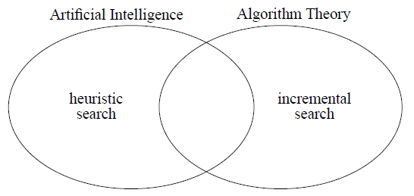
Incremental search + heuristic search
How to search efficiently using heuristic to guide the search
How to search efficiently by re-using information from previous search results
A*
Dynamic SWSF-FP

Slide 4
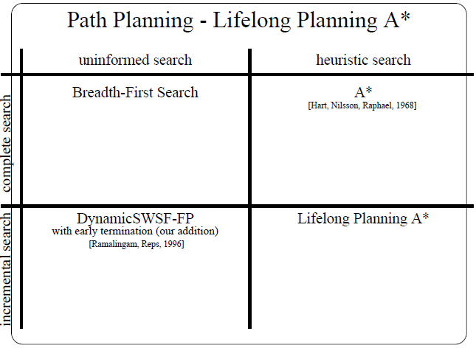
Incremental search + heuristic search

Slide 5
Optimised LPA*
2 other optimisations
Results
ASSIGNMENT#1 - Start-up Code

Slide 6
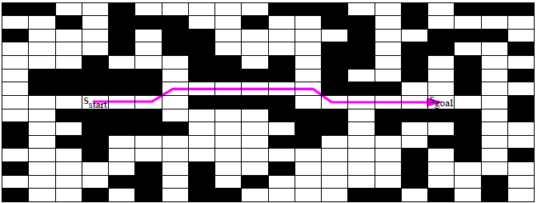
Path Planning
original eight-connected gridworld

Slide 7
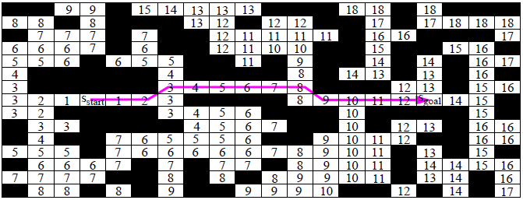
Path Planning
original eight-connected gridworld

Slide 8
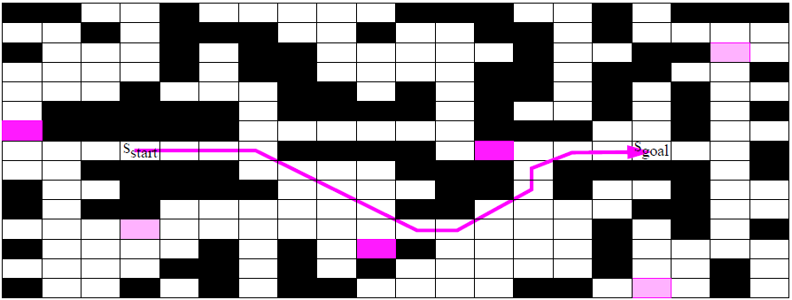
Path Planning
changed eight-connected gridworld

Slide 9
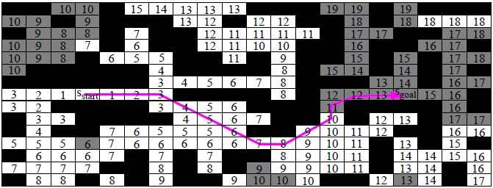
Path Planning
changed eight-connected gridworld

Slide 10
Lifelong Planning A*
Lifelong Planning A*
- applies to the same finite search problems as A*
- produces the same (optimal) solution as A*
- handles arbitrary edge cost changes
- is algorithmically very similar to A*
- is more efficient than A* in many situations
- applies to
- route planning problems (traffic, networking, ...)
- robot control
- symbolic artificial intelligence planning
- has nice theoretical properties

Slide 11
Path-planning
Path-planning problems can be solved with traditional graph-search methods, such as breadth-first search, if they update the shortest path every time some edge costs change.
They typically neither take advantage of available heuristics nor reuse information from previous searches.
The next algorithm, however, shows that taking advantage of these sources of information can potentially be beneficial individually and even more beneficial when they are combined.
Problem Domain: Eight-connected gridworld with cells whose traversability changes over time

Slide 12
Incremental Search
Incremental search methods solve dynamic shortest path problems, that is, path problems where shortest paths have to be determined repeatedly as the topology of a graph or its edge costs change.
S
2
1
3
1
1
1
1
2
1
3
G

Slide 13
Incremental Search
Incremental search methods solve dynamic shortest path problems, that is, path problems where shortest paths have to be determined repeatedly as the topology of a graph or its edge costs change.
S
∞
∞
3
1
∞
1
1
2
1
3
G
A cell gets blocked.

Slide 14
Incremental Search
If arbitrary sequences of edge insertions, deletions, or weight changes are allowed, then the dynamic shortest path problems are called fully dynamic shortest path problems
7
4
S
∞
∞
3
2
∞
1
1
2
1
3
G

Slide 15
Incremental Search
LPA* is an incremental search method that solves fully dynamic shortest path problems.
It uses heuristics to focus its search and thus combines two different techniques to reduce its search effort.

Slide 16
Lifelong Learning
“Lifelong learning” because it reuses information from previous searches. (Other researchers use the term continual planning for the same concept.)
LPA* repeatedly finds shortest paths from a given start vertex to a given goal vertex in a given graph as edges or vertices are added or deleted or the costs of edges are changed, for example, because the cost of planning operators, their preconditions, or their effects change from one path-planning problem to the next.
LPA* generalizes both DynamicSWSF-FP (incremental) and A* (heuristic) and promises to find (re-plan) shortest paths faster than these two search methods individually because it combines their techniques.
Univ. of Wisconsin, G. Ramalingam - Strict Weakly Superior Function-FP

Slide 17
LPA* vs. A*
Its first search is the same as that of a version of A* that breaks ties among vertices with the same f-value in favour of smaller g-values
the subsequent searches are potentially faster because it reuses those parts of the previous search tree that are identical to the new search tree, and uses an efficient method for identifying these parts.
This can reduce the search time if large parts of the search trees are identical, for example, if the path-planning problems change only slightly and the changes are close to the goal.
LPA* can also handle changes to the graph during its search and can be extended to inadmissible heuristics, more efficient tiebreaking criteria, and nondeterministic graphs

Slide 18
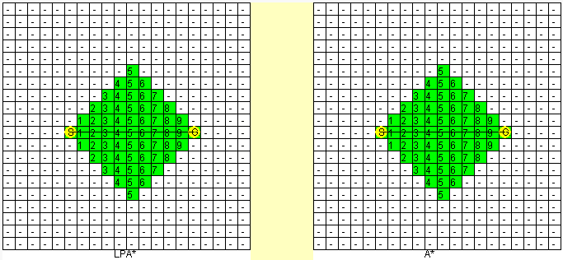
LPA* vs. A*
INITIAL SEARCH RESULTS
LPA*’s initial search is the same as that of A* that breaks ties among vertices with the same f-cost in favour of smaller g-values.
Green cells – nodes expanded once
http://idm-lab.org/applet.html

Slide 19
LPA* vs. A*
INITIAL SEARCH RESULTS
LPA*’s initial search is the same as that of A* that breaks ties among vertices with the same f-cost in favour of smaller g-values.
However, LPA* expands vertices more slowly than A*.
Green cells – nodes expanded once
http://idm-lab.org/applet.html

Slide 20
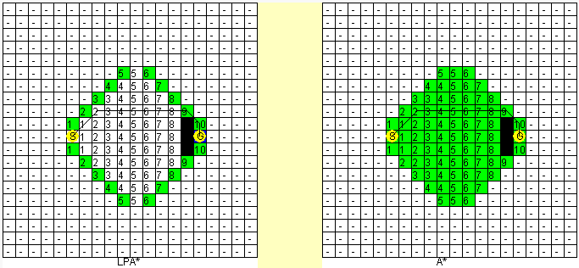
LPA* vs. A*
REPLANNING RESULTS
Cells close to the Goal gets blocked.
During subsequent searches, LPA* often expands fewer vertices than A*, and is thus faster.
Can you imagine a real-world scenario where this applies?
http://idm-lab.org/applet.html

Slide 21
LPA* vs. A*
REPLANNING RESULTS
Cells close to the Goal gets blocked.
In an aeromedical evacuation scenario, airplanes might no longer be able to pass through regions that catch fire.
Can you imagine a real-world scenario where this applies?
http://idm-lab.org/applet.html

Slide 22
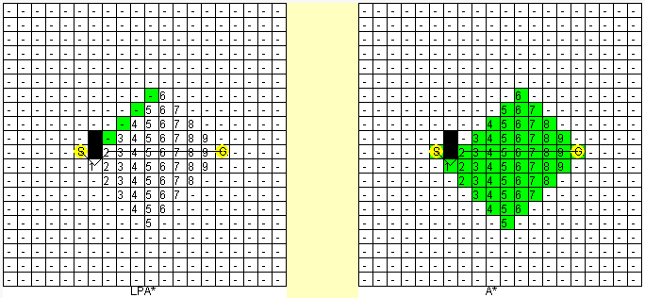
LPA* vs. A*
REPLANNING RESULTS
Cells close to the Start node gets blocked.
Can you imagine a real-world scenario where this applies?
http://idm-lab.org/applet.html

Slide 23
LPA* vs. A*
REPLANNING RESULTS
Cells close to the Start node gets blocked.
If the robot is using a faulty map and discovers obstacles later on, via its on-board sensors, while navigating towards the goal.
Can you imagine a real-world scenario where this applies?
http://idm-lab.org/applet.html

Slide 24
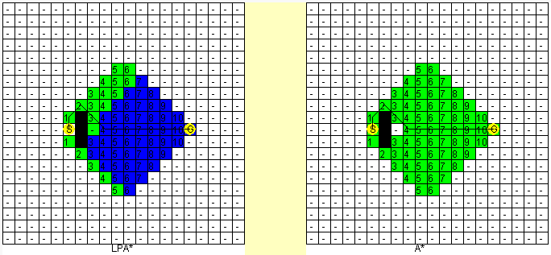
LPA* vs. A*
REPLANNING RESULTS
Cells close to the Start node gets blocked.
However, as more obstacles appear close to the START node, LPA* performs more work replanning.
Blue cells – nodes expanded twice
How bad is this for LPA*?
http://idm-lab.org/applet.html

Slide 25
Sample Run: LPA* vs. A*
REPLANNING RESULTS (size: 561 x 561 gridworld, 4-connected, obstacle density = 0.30)
Much bigger grid, 100 gridworlds, 500 replanning episodes per run, 20% chance of change in cells, start and goal vertices drawn with uniform probability.
Algorithm | expansions/replanning episode | Total time/run
LPA* | 469.06 | 306.14
A* v.1 | 5610.43 | 558.85
A* v.2 | 5396.72 | 434.18
A* v.1 - A* breaks ties in favor of cells with smaller g-values.
A* v.2 - A* breaks ties in favor of cells with larger g-values.
http://idm-lab.org/applet.html

Slide 26
A* v.1 versus A* v.2
A* v.1
breaks ties in favour of vertices with smaller g-values.
A* v.2
breaks ties in favour of vertices with larger g-values.
If there are multiple shortest paths and a large number of cells on these paths have f-costs that are equal to the f-cost of the Goal vertex, A* v.1 expands all of these vertices.
On the other hand, A* v.2 expands only those vertices on the shortest path
LPA*
LPA* breaks ties in the same way as A* v.1.
Nevertheless, LPA* outperforms even A* v.2, in the long run.
http://idm-lab.org/applet.html

Slide 27
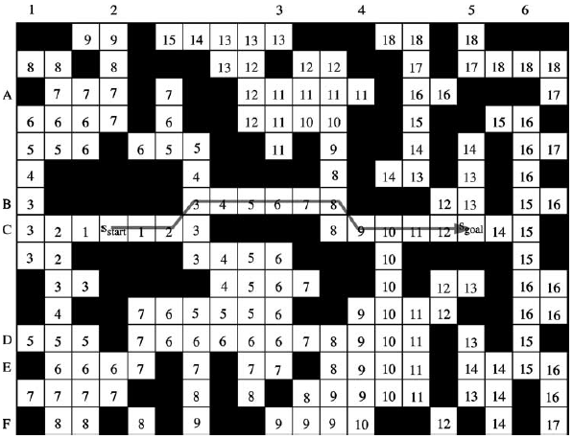
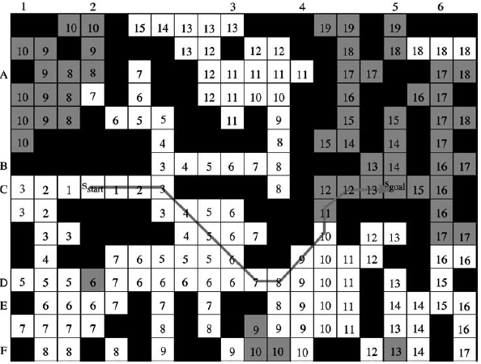
Eight-connected gridworld
(Original)
(Changed)
Two percent of the cells changed their status but the obstacle density remained the same.
three blocked cells became traversable (namely, A6, D2, and F5) and three
traversable cells became blocked (namely, B1, C4, E3)
The start distances are shown in each traversable cell of the original and changed gridworlds.
Those cells whose start distances in the changed gridworld have changed from the corresponding ones in the original gridworld are shaded gray

Slide 28
Eight-connected gridworld
(Original)
(Changed)
Two percent of the cells changed their status but the obstacle density remained the same.
three blocked cells became traversable (namely, A6, D2, and F5) and three
traversable cells became blocked (namely, B1, C4, E3)
The start distances are shown in each traversable cell of the original and changed gridworlds.
Those cells whose start distances in the changed gridworld have changed from the corresponding ones in the original gridworld are shaded gray

Slide 29
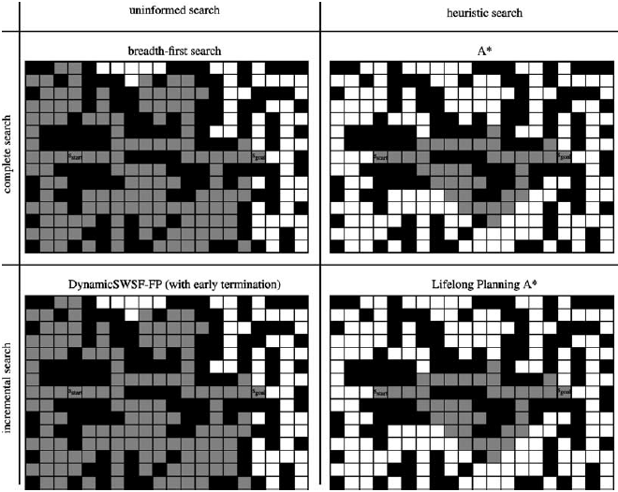
(Original) Eight-connected gridworld
Those cells whose start distances in the changed gridworld have changed from the corresponding ones in the original gridworld are shaded gray

Slide 30
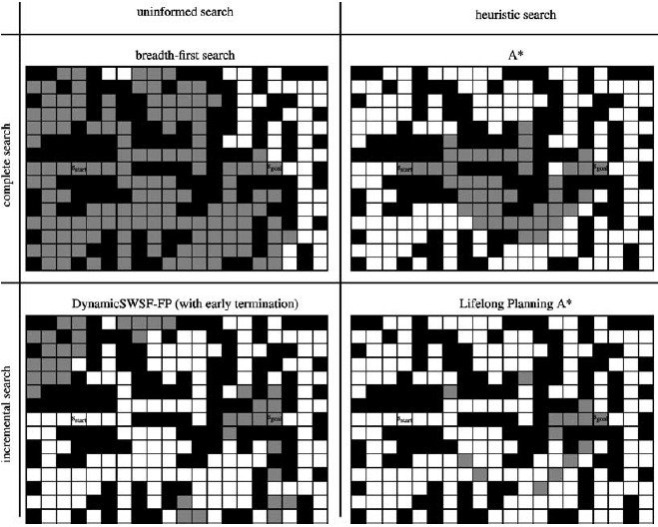
(Changed) Eight-connected gridworld
Those cells whose start distances were recomputed (expanded cells) are shaded gray.

Slide 31
LPA*
LPA* is an incremental version of A* that applies to the same finite path-planning problems as A*.
It shares with A* the fact that it uses non-negative and consistent heuristics h(s) that approximate the goal distances of the vertices s to focus its search.
Consistent heuristics obey the triangle inequality:
h(s_{goal}) = 0
h(s) ≤ c(s, s’) + h(s’); for all vertices s ∈ S and
s’ ∈ succ(s) with s ≠ s_{goal}.

Slide 32




Variables
S finite set of vertices
set of successors of s
set of predecessors of s
Cost of moving from vertex s to vertex s’
Start vertex
Goal vertex

Slide 33

Variables
Start distance = length of the shortest path from S_{start} to S
g(s) = estimate of the Start distance g*(s)

Slide 34
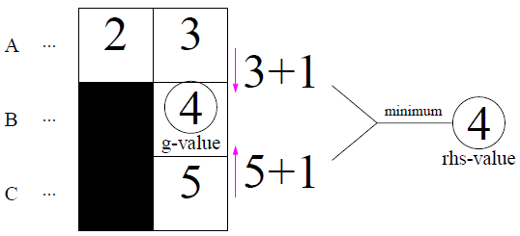

Rhs-value
The rhs-values are one-step look-ahead values, based on the g-values; and thus, potentially better informed than the g-values

Slide 35
Rhs-value
The rhs-values are one-step look-ahead values, based on the g-values and thus potentially better informed than the g-values
g-value == rhs-value: cell is locally consistent
g-value ≠ rhs-value: cell is locally inconsistent
g-value > rhs-value: cell is locally overconsistent
g-value < rhs-value: cell is locally underconsistent
the priority queue contains exactly the locally inconsistent vertices s
their priority is [min(g(s),rhs(s))+h(s,sgoal); min(g(s),rhs(s))]
smaller priorities first, according to a lexicographic ordering

Slide 36
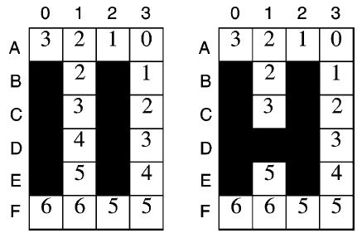
Shortest Path
If all vertices are locally consistent,
g(s) == g*(s) ; for all vertices s
one can trace back the shortest path from S_{start} to any vertex s.
Start = A3, Goal = F0
6
7
from S_{goal} to S_{start}
From vertex s, find a predecessor s’ that minimises g(s’) + c(s, s’). Ties can be broken arbitrarily.
Repeat until S_{start} is reached.

Slide 37
Selective Update
LPA* does not make all vertices locally consistent after some edge costs have changed
It uses heuristics to focus the search
It updates only the g-values that are relevant for computing the shortest path
LPA* maintains a priority queue for keeping track of locally inconsistent vertices – vertices that potentially needs their g-values updated to make them locally consistent
Start = A3, Goal = F0
6
7

Slide 38
Priority
LPA* maintains a priority queue for keeping track of locally inconsistent vertices – vertices that potentially needs their g-values updated to make them locally consistent
Priority of a vertex = key
Key – vector with 2 components
k(s) = [ k₁(s); k₂(s) ]
k₁(s) = min(g(s), rhs(s)) + h(s, s_{goal})
k₂(s) = min(g(s), rhs(s))

Slide 39
Priority
Priority of a vertex = key
Key – vector with 2 components
k(s) = [ k₁(s); k₂(s) ]
k₁(s) = min(g(s), rhs(s)) + h(s, s_{goal})
k₂(s) = min(g(s), rhs(s))
The vertex with the smallest key is expanded first by LPA*.
Key comparison (lexicographic ordering):
k(s) ≤ k’(s) iff either ( k₁(s) < k₁‘(s) )
or ( k₁(s) == k₁‘(s) ) and
( k₂(s) ≤ k₂‘(s) )

Slide 40
Heuristic Function (Gridworld)
As an approximation of the distance between two cells, we use the maximum of the absolute differences of their x and y coordinates.
These heuristics are for eight-connected gridworlds what Manhattan distances are for four-connected gridworlds.

Slide 41
LPA* Pseudocode
The pseudocode uses the following functions to manage the priority queue U:
U.TopKey() - returns the smallest priority of all vertices in priority queue U.
(If U is empty, then U.TopKey() returns [∞; ∞].)
U.Pop() - deletes the vertex with the smallest priority in priority queue U and returns the vertex.
U.Insert(s; k) - inserts vertex s into priority queue U with priority k.
Update(s; k) - changes the priority of vertex s in priority queue U to k. (It does nothing if the current priority of vertex s already equals k.)
U.Remove(s) - removes vertex s from priority queue U.

Slide 42
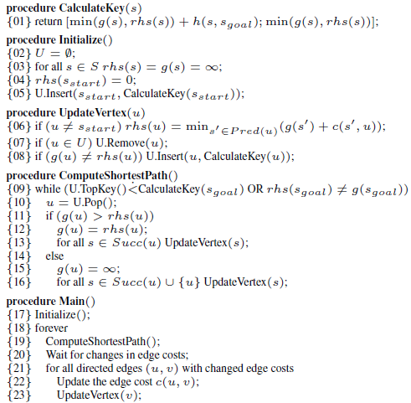
LPA* Pseudocode

Slide 43
Optimisations
ComputeShortestPath() – can also terminate when the goal is overconsistent and its key is <= TopKey : this will avoid expanding the goal vertex unecessarily, but the g-value of the goal will not be used anymore for tracing the shortest path.
If the rhs(Goal) is infinity then there is no path from Start vertex to the goal: will avoid expanding a potentially large number of vertices.

Slide 44
Replanning (not found in journal)
Procedure Replan(New BLOCKED Cell)
a NEW BLOCKED CELL is introduced
For each of the NEIGHBOURS of the NEW BLOCKED CELL
Pick one NEIGHBOUR.
If the NEIGHBOR is NOT an OBSTACLE
disconnect the NEW BLOCKED CELL from the NEIGHBOR
If (the NEIGHBOUR is not the START VERTEX) AND
(the NEIGHBOUR's predecessor is equal to the NEW BLOCKED cell)
UpdateNEIGHBOUR(NEIGHBOUR)
End If
End If
For Next
Procedure UpdateNEIGHBOUR(cell)
rhs(cell) = infinity
predecessor of cell = NULL
For all NEIGHBOURS of Cell
Pick one NEIGHBOUR
IF( rhs(cell) > g(NEIGHBOUR) + 1 )
rhs(cell) = g(NEIGHBOUR) + 1
predecessor of cell = NEIGHBOUR
End If
For Next
If the cell is locally INCONSISTENT calculateKey(cell)
insert cell into heap.
Else
delete cell from heap.
End If

Slide 45
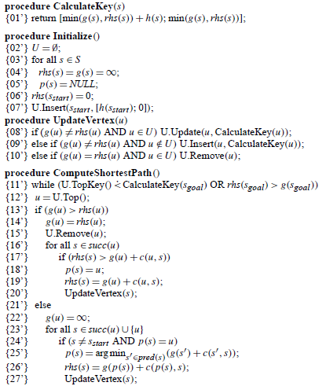
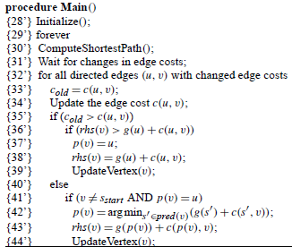
Optimised LPA* Pseudocode
Cell
unblocking
Cell
blocking
Decrease in g-value
increase in g-value

Slide 46
Exercise: Planning & Replanning
Simulate the following 4-connected gridworld using:
(optional) A* with Strict Expanded List (break ties in favour of smallest g-value
LPA*

Slide 47
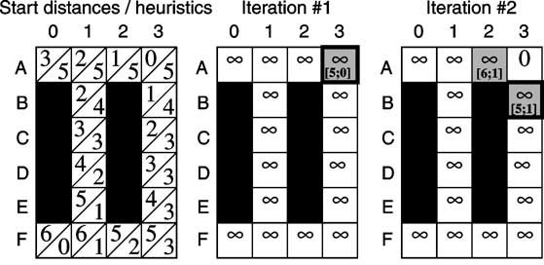
Route-planning example in the eight-connected gridworld

Slide 48
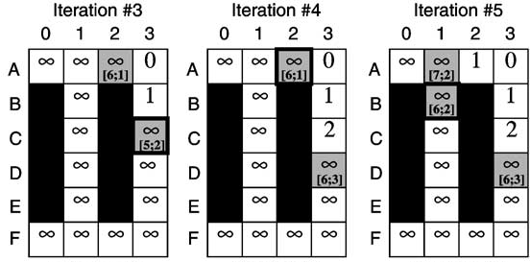
Route-planning example in the eight-connected gridworld

Slide 49
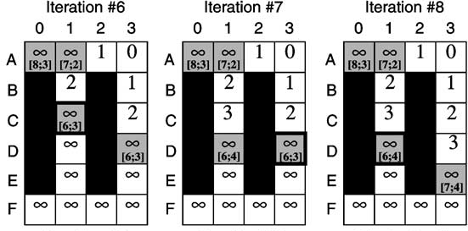
Route-planning example in the eight-connected gridworld

Slide 50
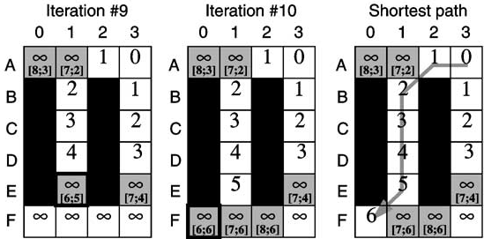
Route-planning example in the eight-connected gridworld

Slide 51
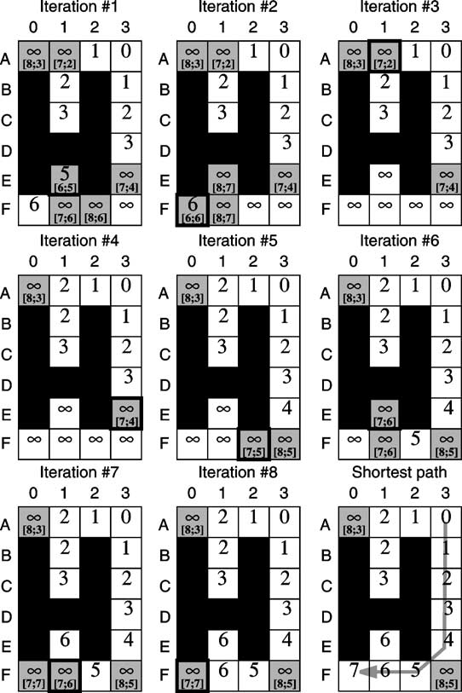
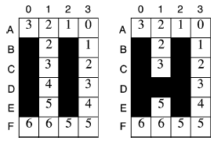
Exercise: Second Search
Previous Search
Principle behind LPA*

Slide 52
Properties
LPA* does not maintain a CLOSED list (expanded list) since it uses local consistency checks to avoid vertex re-expansions.
Replanning with LPA* is best understood as transforming the A* search tree of the old problem to the new one. The larger the overlap between the old and the new search trees and the more start distances remain unchanged, the more efficient replanning becomes. LPA* can be less efficient than A* if the overlap between the search trees is small.

Slide 53
Conclusions
Incremental search methods find optimal solutions to series of similar path-planning problems potentially faster than is possible by solving each path-planning problem from scratch.
They do this by using information from previous search episodes to speed up later searches.
LPA* applies to path-planning problems where one needs to find shortest paths repeatedly as:
edges or vertices are added or deleted,
or the costs of edges are changed, for example, because the cost of planning operators, their preconditions, or their effects change from one path-planning problem to the next.

Slide 54
Conclusions
Lifelong Planning A* generalizes A*. Like A*, it uses heuristics to speed up the current search. Different from A*, it also uses information from previous searches to speed up the current one.
The search effort of Lifelong Planning A* is especially small if the changes occur close to the goal cell. It is usually much smaller than the search effort of A* although it can also be larger (especially if the changes occur close to the start cell)

